Slide 1

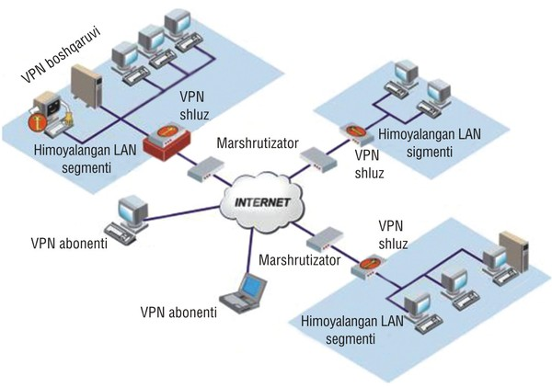
TARMOQ ADMINISTRATORLIGI 6.2-DARS

Slide 2

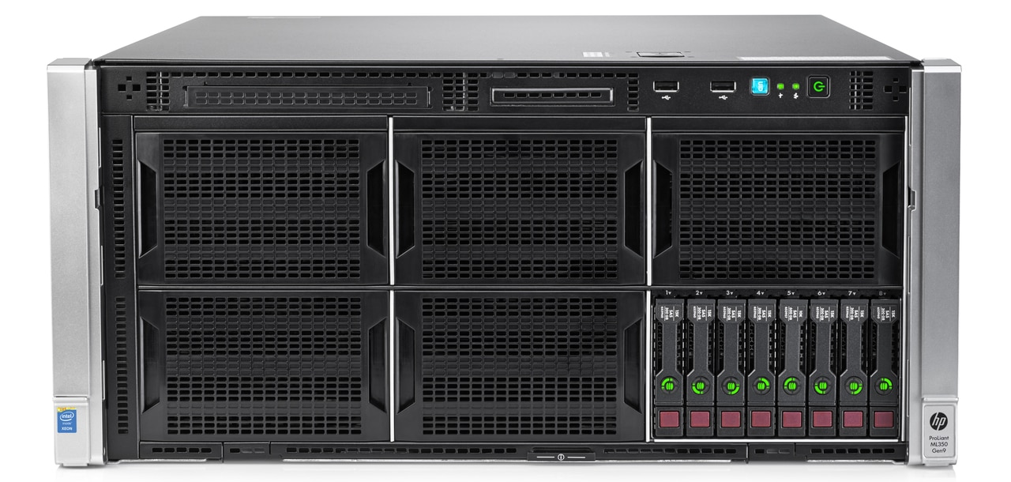
SERVERS

Slide 3

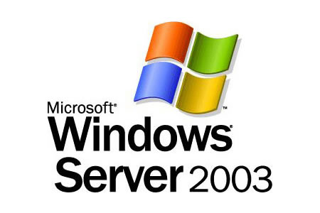
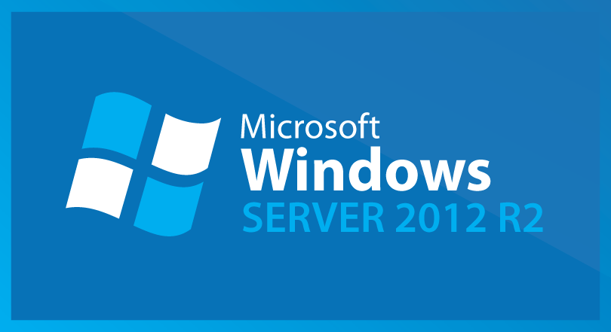


MS WINDOWS SERVERS
Windows NT 3.1 – 1993
Windows NT 3.5 Server – 1994
Windows NT 3.51 Server – 1995
Windows NT 4.0 Server – 1996
Windows 2000 Server – 2000
Windows .NET Server – 2002
Windows Server 2003 R2 – 2003
Windows Server 2008 R2 – 2008
Windows Server 2012 R2 – 2013
Windows Server 2016 R2 – 2016

Slide 4
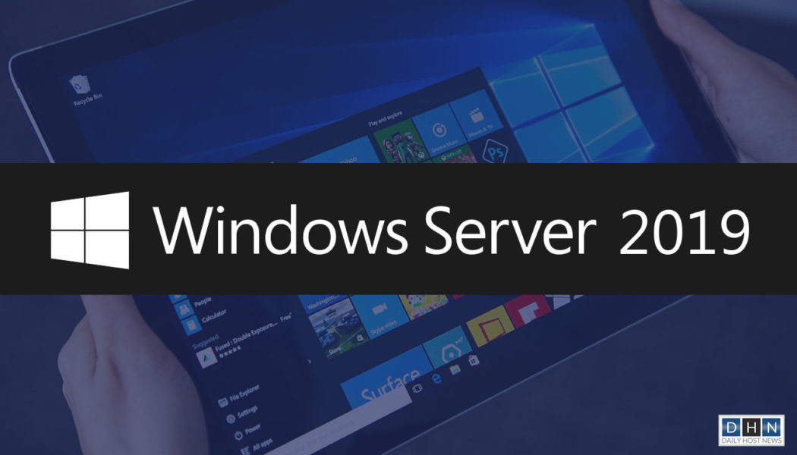
MS WINDOWS SERVERS
Windows Server 2019– 2018 yil

Slide 5
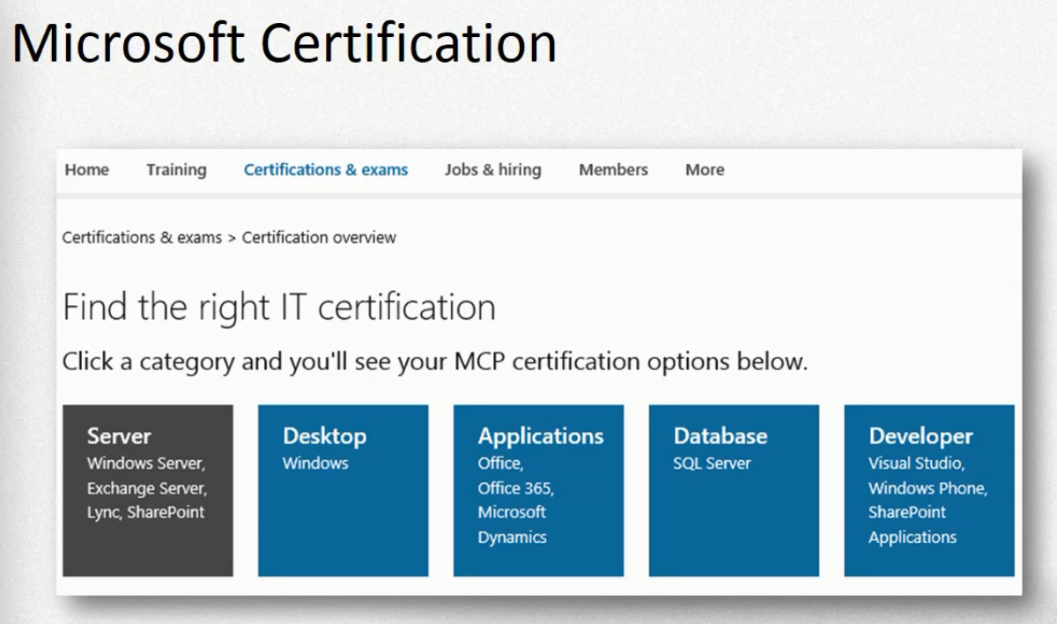

Slide 6
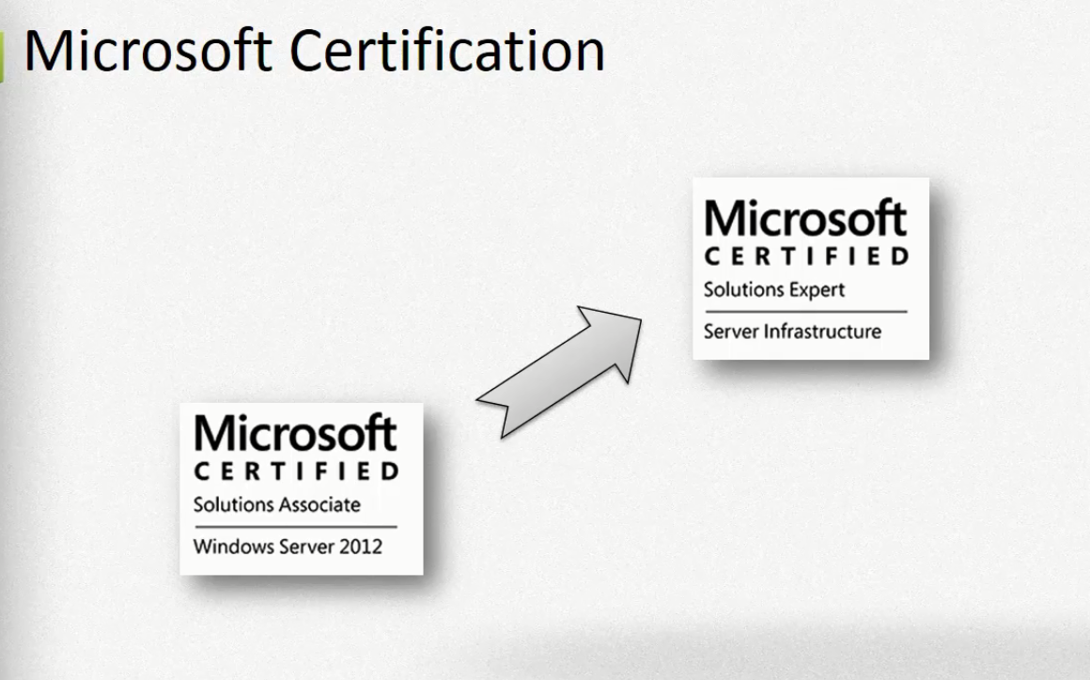

Slide 7
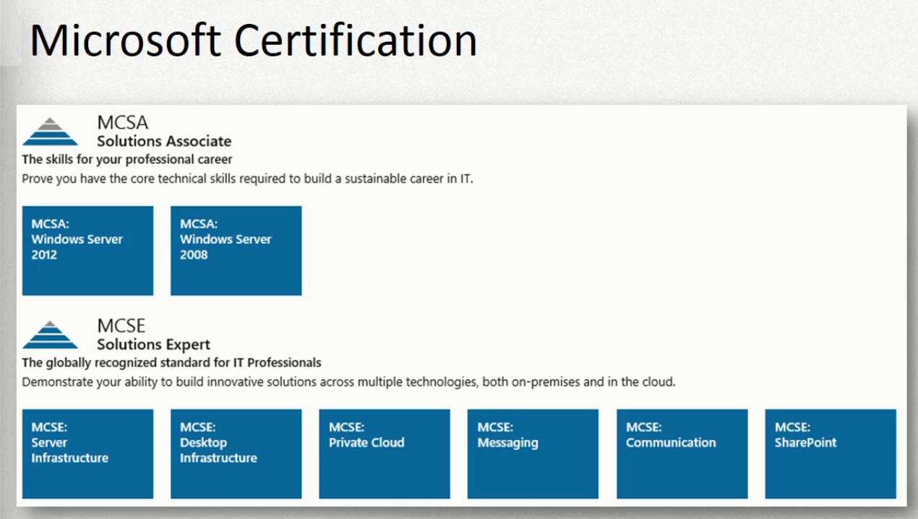

Slide 8
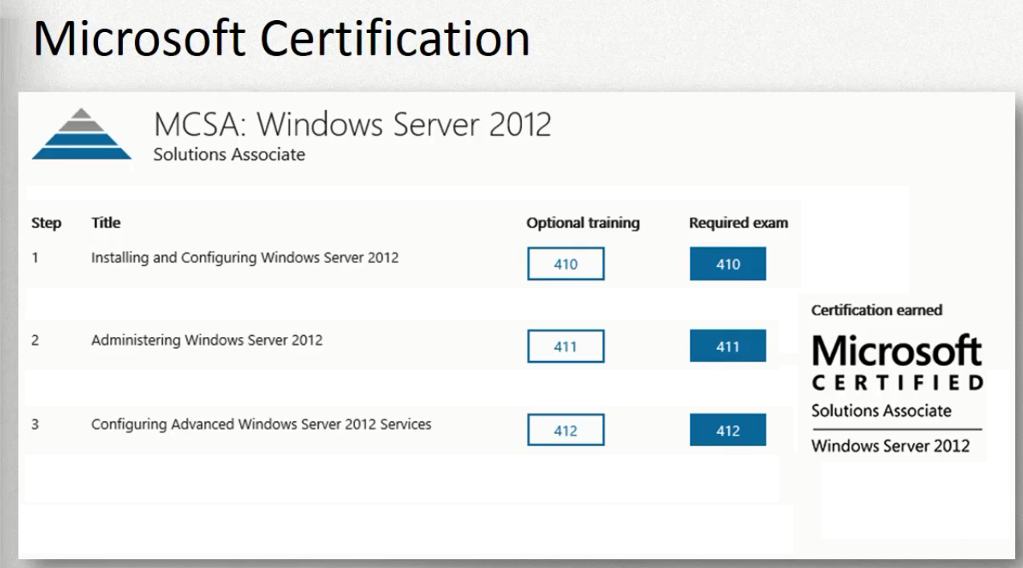

Slide 9
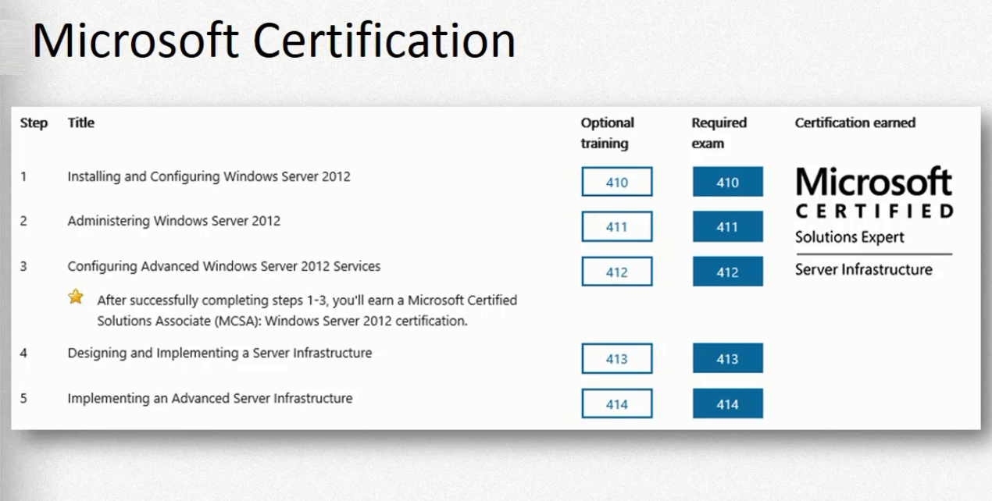

Slide 10
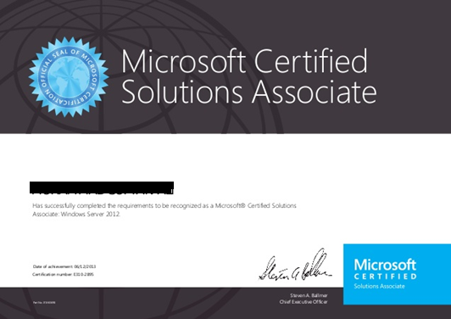
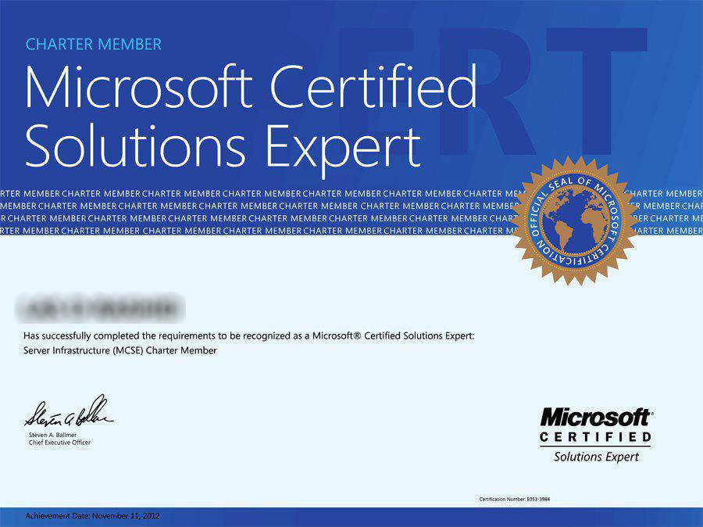
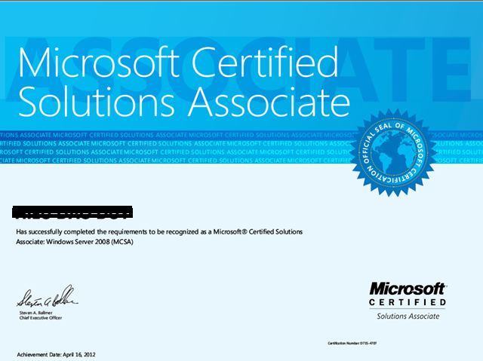
Har bitta exam uchun to’lov: 60 EUR.

Slide 11

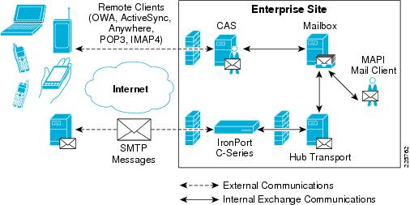
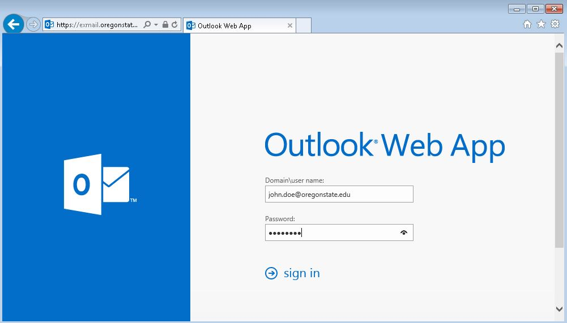
Microsoft Exchange Server

Slide 12
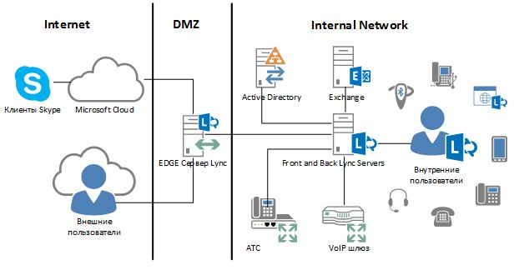

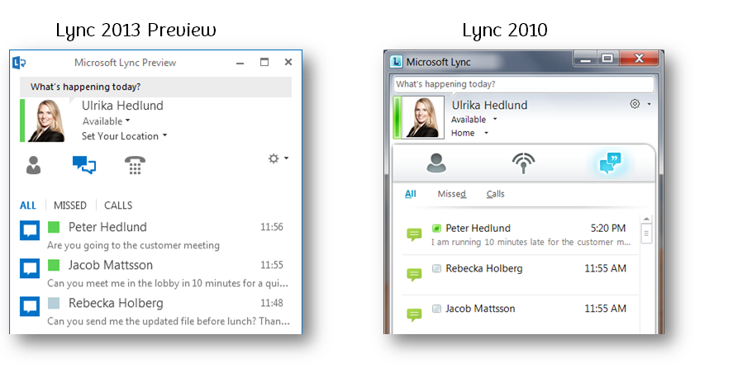
Microsoft Lync Server

Slide 13

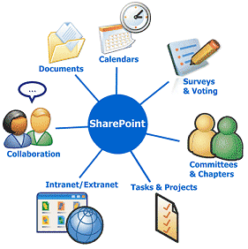
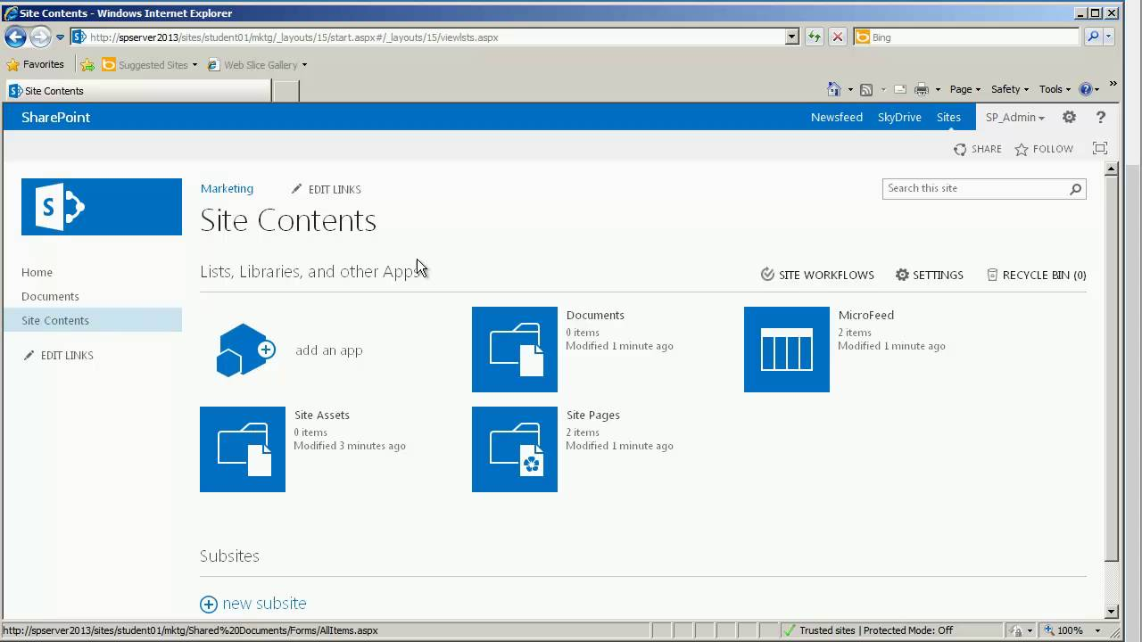
Microsoft Sharepoint Server

Slide 14

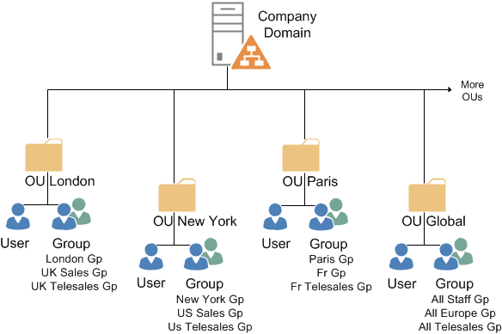
ACTIVE DIRECTORY DOMAIN CONTROLLER (ADDC)

Slide 15
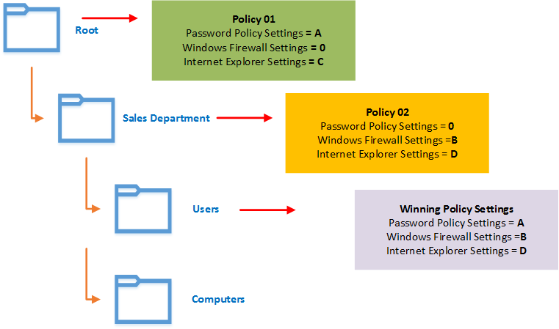
PASSWORD POLICY

Slide 16
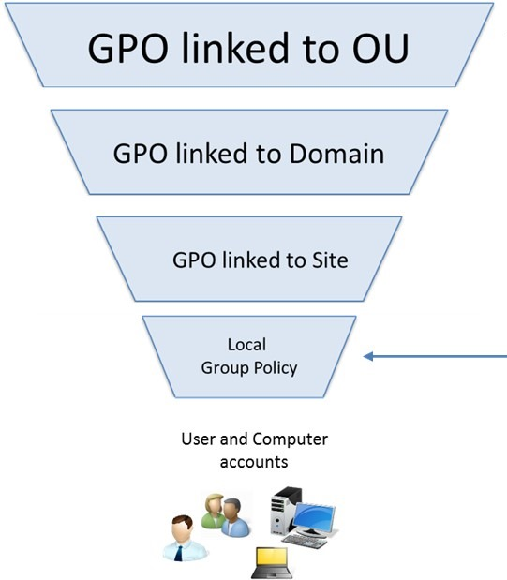
Group Policy Order (GPO)

Slide 17
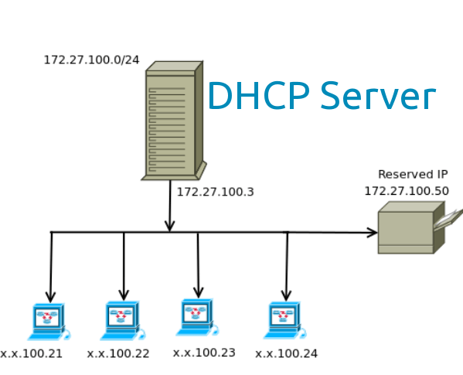
DHCP SERVER

Slide 18
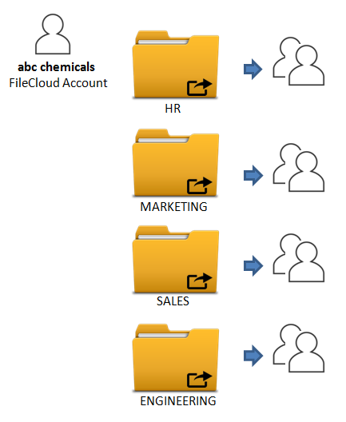
SHARE FOLDER

Slide 19
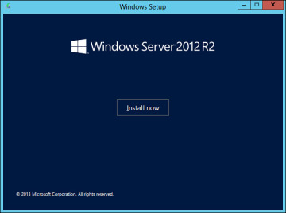
WINDOWS SERVER 2012 R2

Slide 20
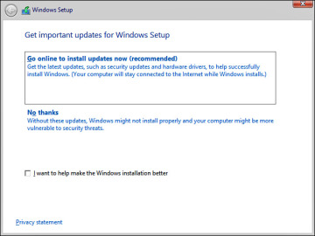
WINDOWS SERVER 2012 R2

Slide 21
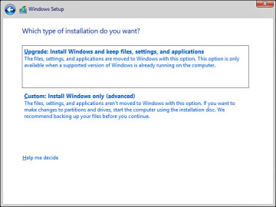
WINDOWS SERVER 2012 R2

Slide 22
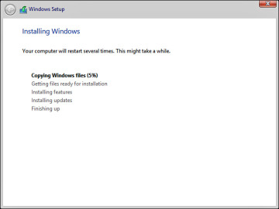
WINDOWS SERVER 2012 R2

Slide 23
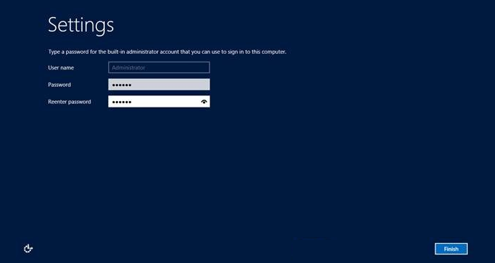
WINDOWS SERVER 2012 R2

Slide 24
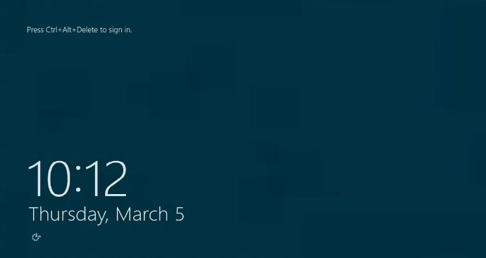
WINDOWS SERVER 2012 R2

